Slide 1
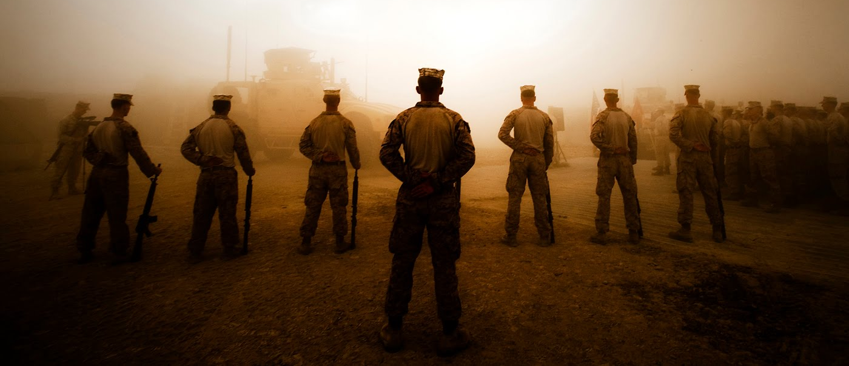
Updated November 2025
Marine Wing Support Squadron 174
Request Mast
Notes:
USE THIS EXAMPLE TO CLARIFY THE UNIT SPECIFIC PROGRAM.

Slide 2
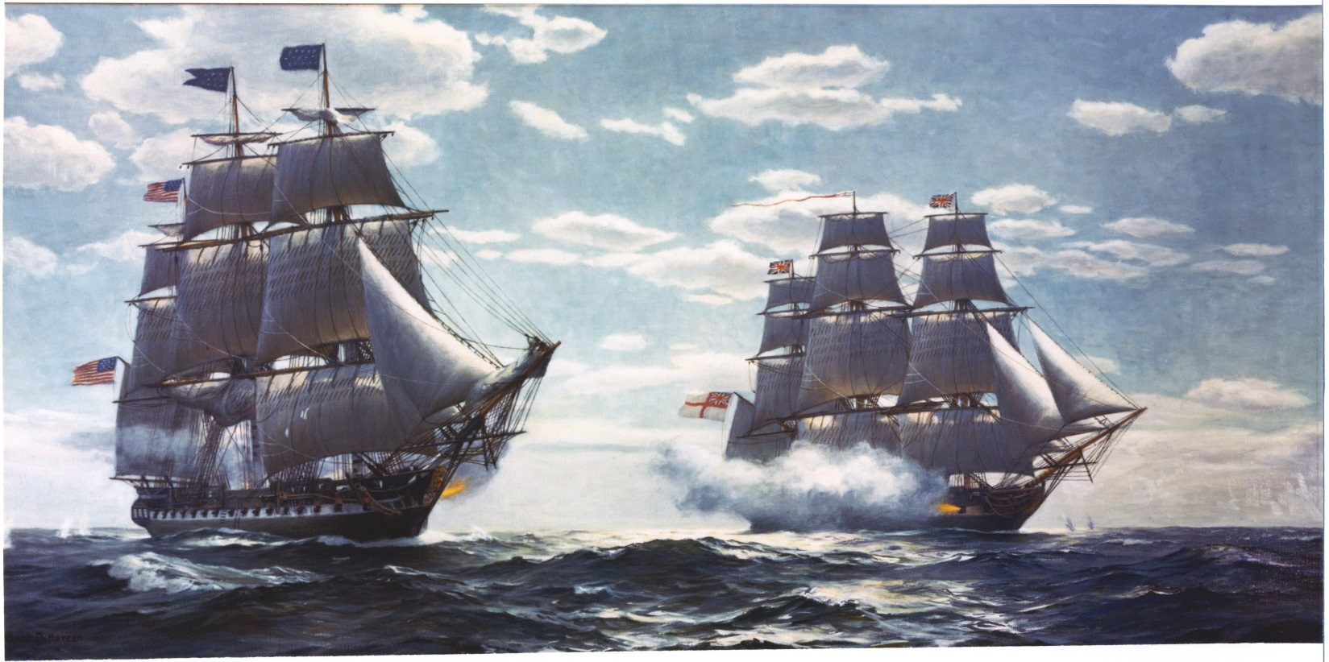
Request Mast Agenda
History & purpose of Mast
Policy for Requesting Mast
Procedures for Requesting Mast
Assistance
2

Slide 3
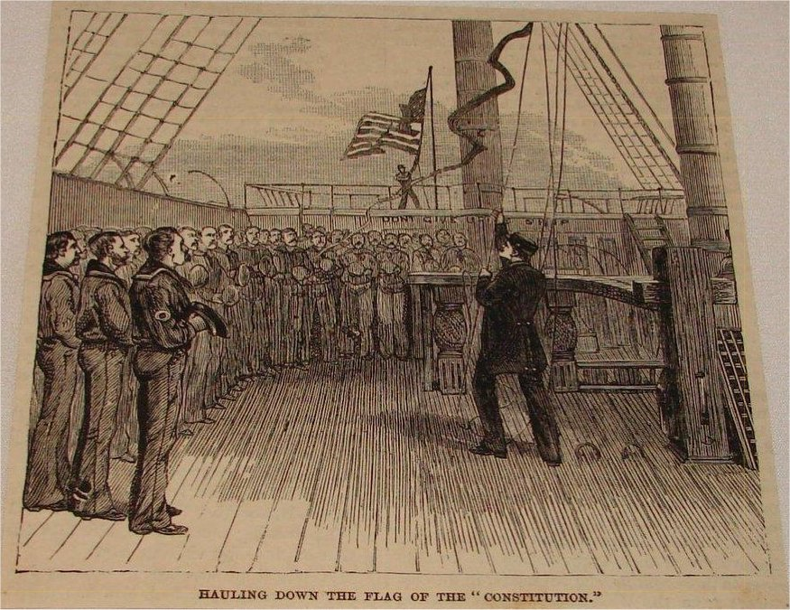
The History of Mast
Naval tradition
Commander’s interaction with ship’s crew
  Dispense punishment
  Present awards
  Accept grievances
Ship’s crew had guaranteed right to speak to their Commander
Solutions were not assured
3
Notes:
The term Mast goes back to the time of the sail ship, when the crew would meet at the mainmast. Masts could be held by different officers; therefore, there were admiral’s Mast, chaplain’s Mast, etc. When the Commander (captain) of the ship held a mast, he would dispense punishment, present awards, or accept grievances. Hence, Captain’s Mast, Meritorious Mast, and …Request Mast.

Slide 4
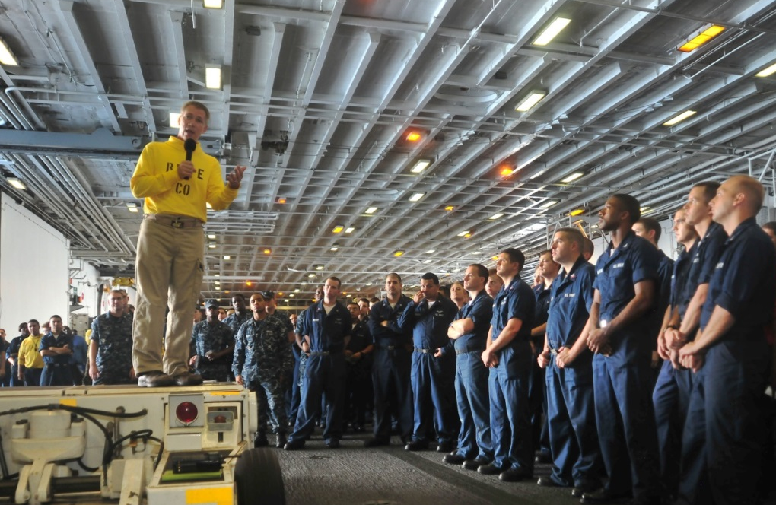
Purpose of Mast
Convey grievances directly to the Commander
Provides a personal audience with Commander*
Expedite processing of urgent concerns
Should employ the entire Chain of Command to assist
Should not dismiss the “Chain of Concern”
Should not replace established staff functions
Should never supplant informal discourse
* Appearance with Commander should not present a conflict of interest or affect neutrality
4

Slide 5
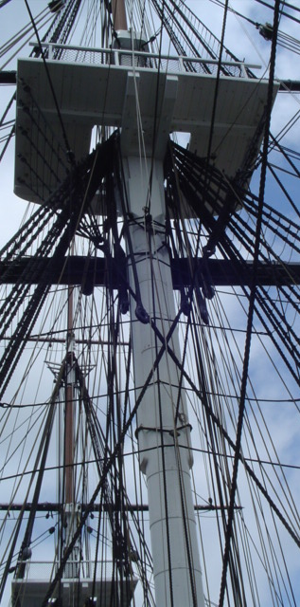
Request Mast Policy
According to Marine Corps Order 1700.23G, it is "the right of all Marines to directly seek assistance from, or communicate grievances to, their commanding officers." A Marine has "the opportunity to communicate not only with his or her immediate commanding officer, but also with commanders up to and including a Commanding General (CG) within the chain of command at the same base or immediate geographical location."
MCO 1700.23G
NAVMC 11296 (form)
Are there better avenues of redress?
Not appropriate for Mast:
  Nuisance requests
  Matters dealing w/ UCMJ or ADSEP
      Contemplated, pending, in progress, or final
  Administrative Actions
  Performance Evaluation
5

Slide 6




The Chain of Command
WHO CAN I REQUEST MAST TO?
Only Officers with NJP Authority
  may be I&I, OIC, or Acting
Individual Company Commander
  RANK NAME
Battalion/Squadron Commander
  RANK NAME
Regimental/Group Level Commander
  RANK NAME
MSC Commanding General
  RANK NAME
6

Slide 7
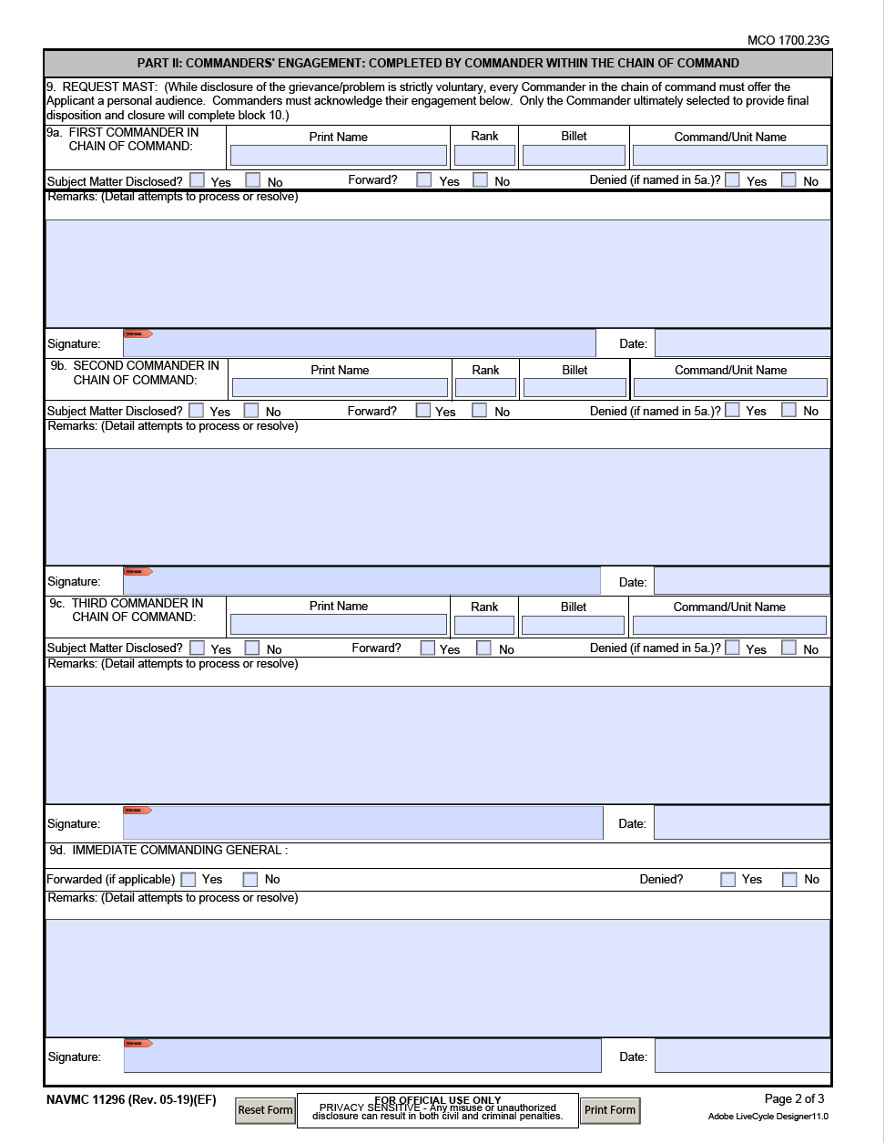
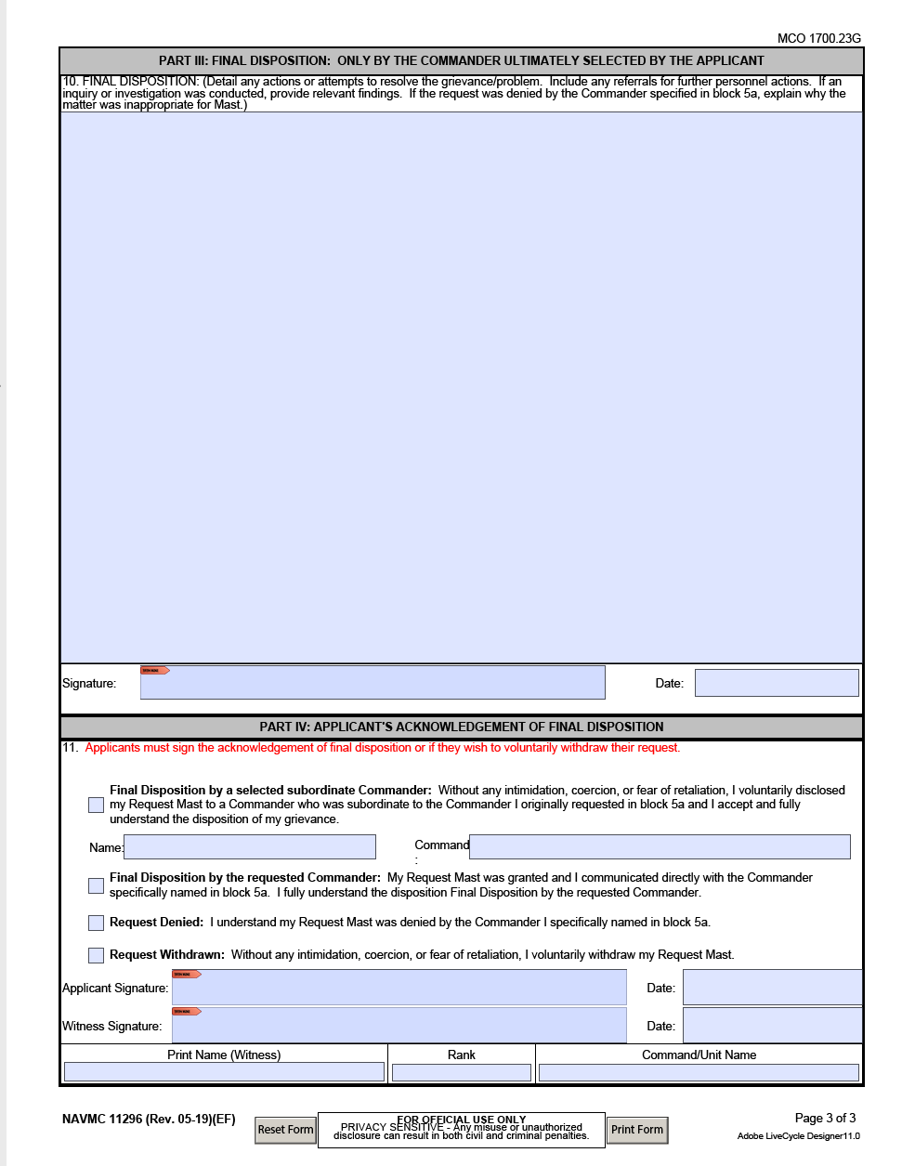
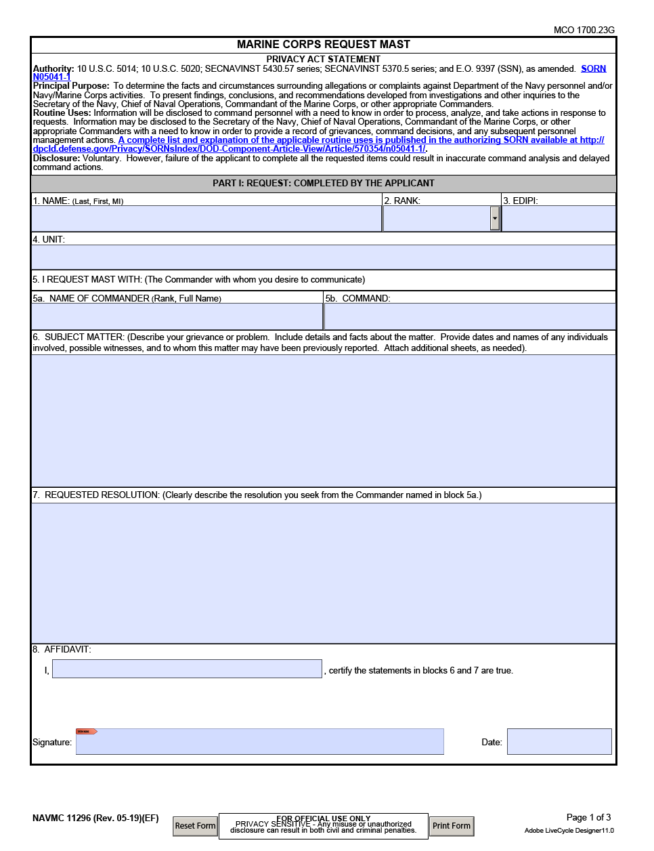
Request Mast Procedure
NAVMC 11296 (5-19)
  Filled out, signed, & dated
Role of the Applicant
  Be a truthful provider of facts
  Forward via the chain of command
  If applicant does not want to disclose the matters, place in a secured envelope and write, “TO BE OPENED BY (RANK NAME or CG) ONLY”
USE THIS SPACE TO EXPLAIN UNIT SPECIFIC INSTRUCTIONS; e.g. emailing form to higher, page 2 on the outside of secured envelopes, etc.
7
Notes:
NAVMC 11296 (5-19) can be digitally signed for processing over distance.
The applicant should allow the chain of command an opportunity to address the complaint, but applicant is not required to disclose issue with anyone other than desired commander.
For this purpose the “chain of concern” is anyone in the chain of command that is not a commander. If grievance is disclosed to the chain of concern expedite the request and assist commander as needed.

Slide 8
Request Mast Procedure
Role of the “Chain of Concern”
  Leaders at all levels should assist the Marine or Sailor with completing the NAVMC.
  Expedite request
  Do not stop Mast and try to resolve it
Role of the Chain of Command
  Expedite audience with the Commander
    Typically the commander will hear the mast within (1) business day
  If disclosed, try to resolve at the lowest level of command
  Explain disposition, delays, and denials
    A face-to-face explanation may not be required for some denials
  The Commander will notify the CG if it is denied
  Ensure no adverse or prejudicial action is taken against a Marine as a result of exercising the right to request mast.
8
Notes:
NAVMC 11296 (5-19) can be digitally signed for processing over distance.
The applicant should allow the chain of command an opportunity to address the complaint, but applicant is not required to disclose issue with anyone other than desired commander.
For this purpose the “chain of concern” is anyone in the chain of command that is not a commander. If grievance is disclosed to the chain of concern expedite the request and assist commander as needed.

Slide 9
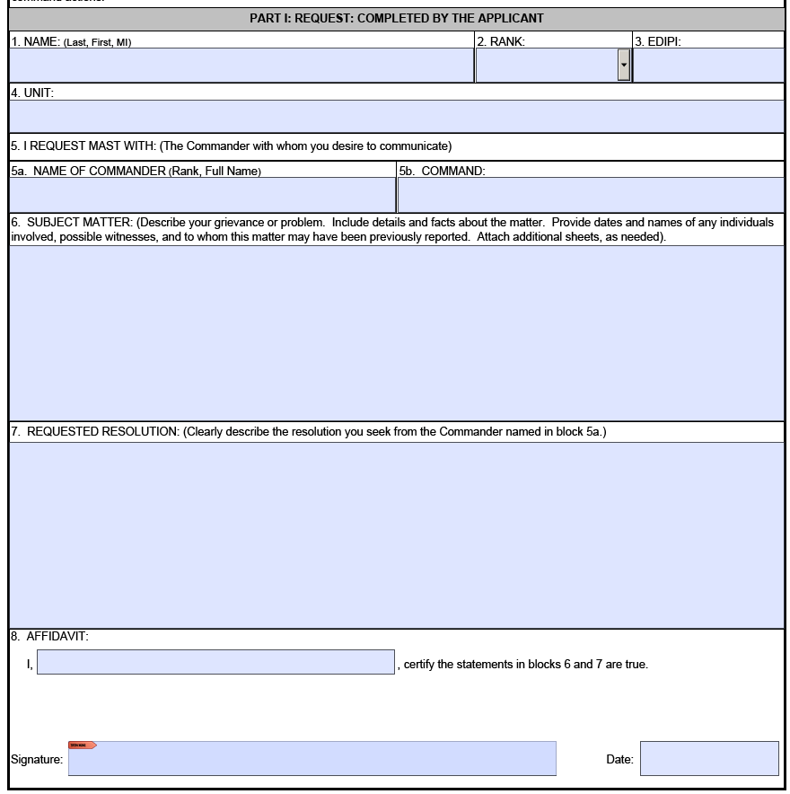
Request Mast Procedure
Personal, contact, and biographical data.
What Commander is requested?
What is the problem?
What is the desired “solution”?
Legal affidavit must be signed and dated. “Starts the Clock”
9

Slide 10
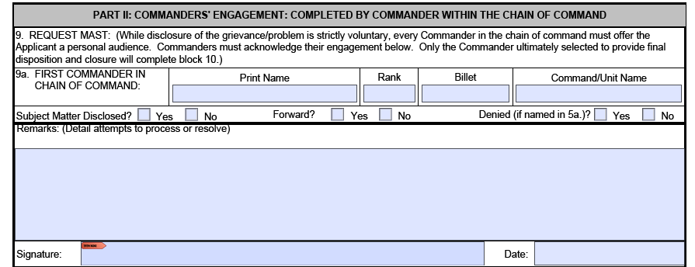
Request Mast Procedure
Each Commander’s data.
Answer
- Commander should document any attempt to resolve grievance or engagement with applicant as well as amplify answers to above questions.
- The date and time the commander and SNM met should be documented.
Commanders NOT taking final disposition shall complete part II.
If Marine accepts a subordinate commander from the commander in block 5a, accepted commander can skip Part II and go to Part III.
Commander must be signed and dated.
10

Slide 11
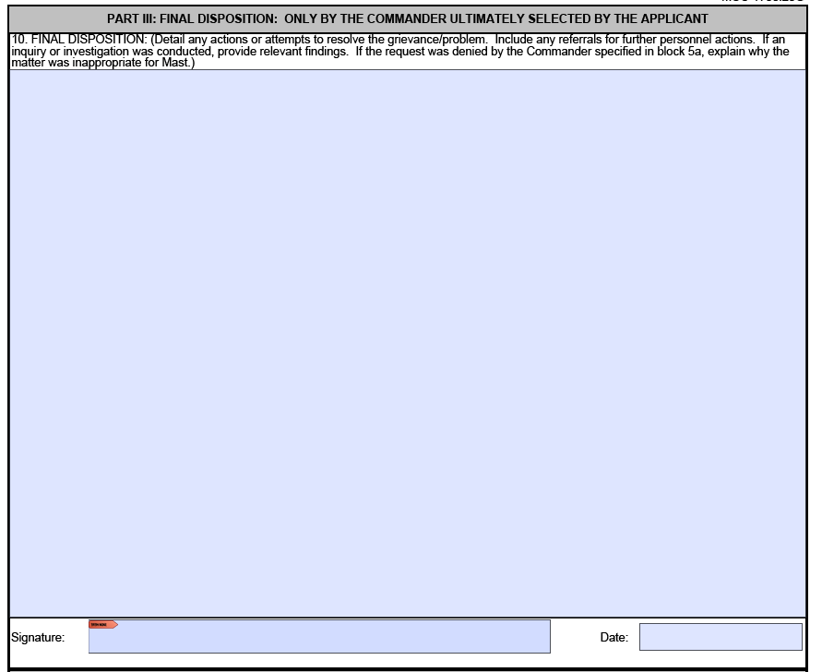
Request Mast Procedure
To uphold faith in the system, we get the Marine quickly before their Commander.
Actually resolving the issue correctly may take time, and must be tracked.
Final disposition; issue may not be resolved immediately
Final Commander to engage with Applicant. Sign & date, stops the clock
11
Notes:
A commander must use discretion in the timing of completing the NAVMC.
If the resolution is straight forward and easily documented, the commander can sign the form and use the follow up ensure actions are completed.
If there is no simple solution, the commander may need time to research the grievance and possible solutions before deciding the course of action. If that is the case, the applicant should be thoroughly briefed.
If actions such as a command investigation or legal proceedings are warranted, the commander does not need to wait for the results to inform the Marine of the intended actions. The Marine is not guaranteed to be satisfied with the actions taken.

Slide 12
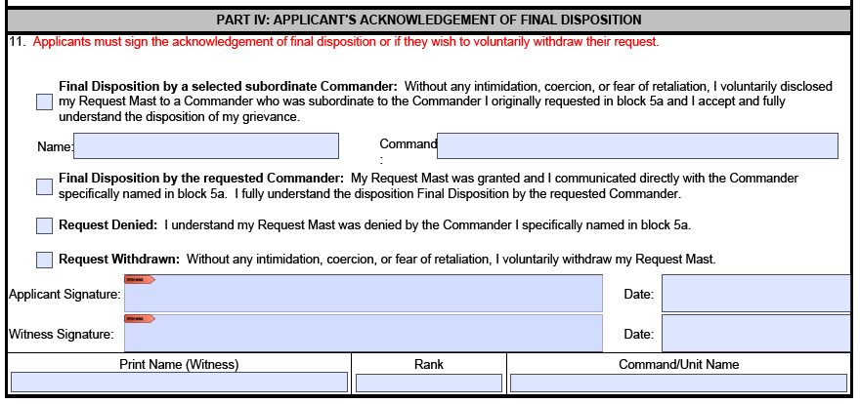
Request Mast Procedure
Applicant selects one acknowledgement.
Applicant and witness sign and date.
If a subordinate commander, to the commander in block 5a, is accepted by the Marine and resolves the issue that subordinate commander is acknowledged in Part III and the Request for Mast is NOT forwarded any higher. ONLY Commanders can be acknowledged in Part III.
12
Notes:
The first acknowledgement is used when the applicant accepts a commander not identified in block 5a, but the applicant accepts to resolve the grievance.
The second acknowledgement is used when the commander identified in block 5a grants the Mast and the Marine understands the proposed disposition.
Any denied Masts are acknowledged with the third block and explained in block 10.
If the Marine wishes to withdraw the Request Mast of without persuasion, use the last acknowledgement. A best practice is having the Marine document in block 10 his reasoning for withdrawing the Mast.

Slide 13
Assistance
Marines, Sailors, or Officers needing assistance with completing the NAVMC 11296 can contact the chain of command or:
  First Sergeant
  Sergeant Major
  Executive Officer
  OTHER POCs (e.g. S-1 Chief, EOR, Platoon Sergeant)
  MCS Inspector General

Slide 14
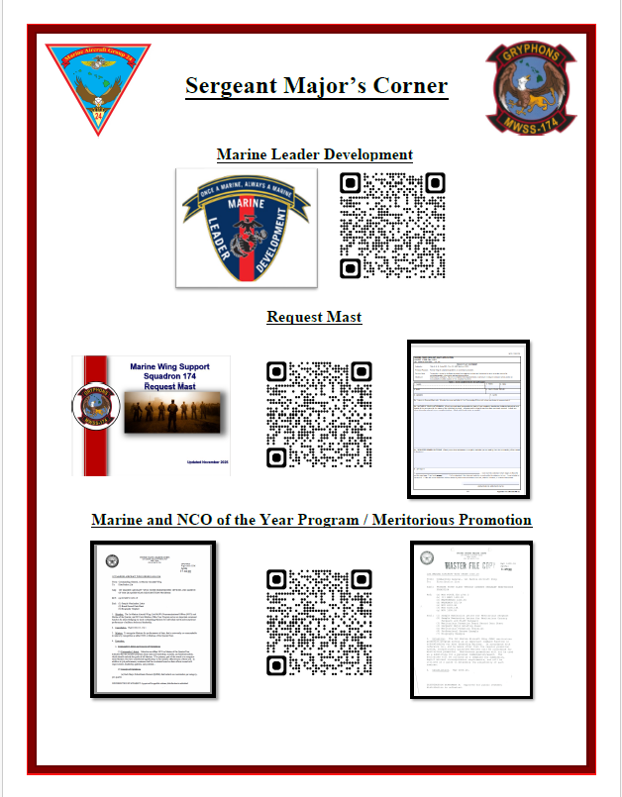
References
Marines, Sailors, or Officers needing assistance can utilize QR codes to locate NAVMC 11296 (5-19).

Slide 15
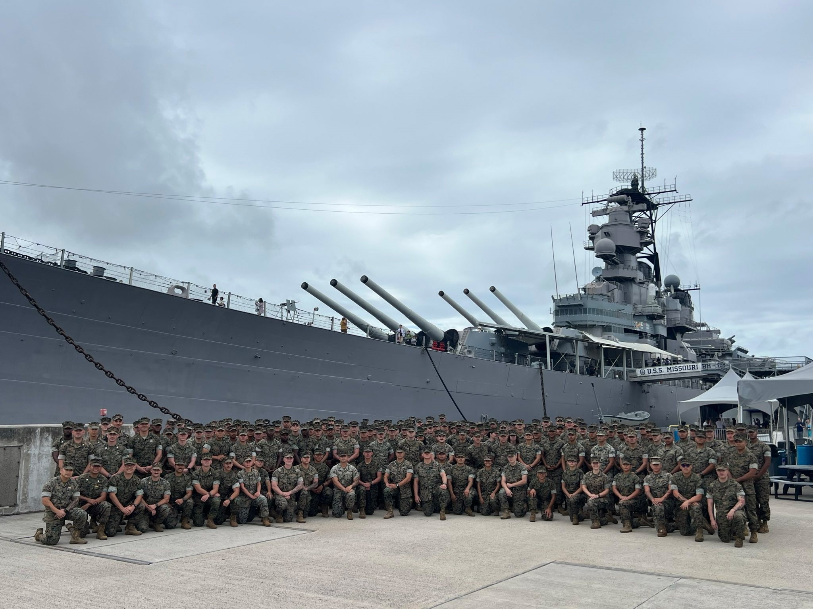
Questions
15
Notes:
a

