Slide 1
Marine Leader Development
MCO 1500.61
By: SgtMaj Christopher L. Rivera
8 January 2026

Slide 2
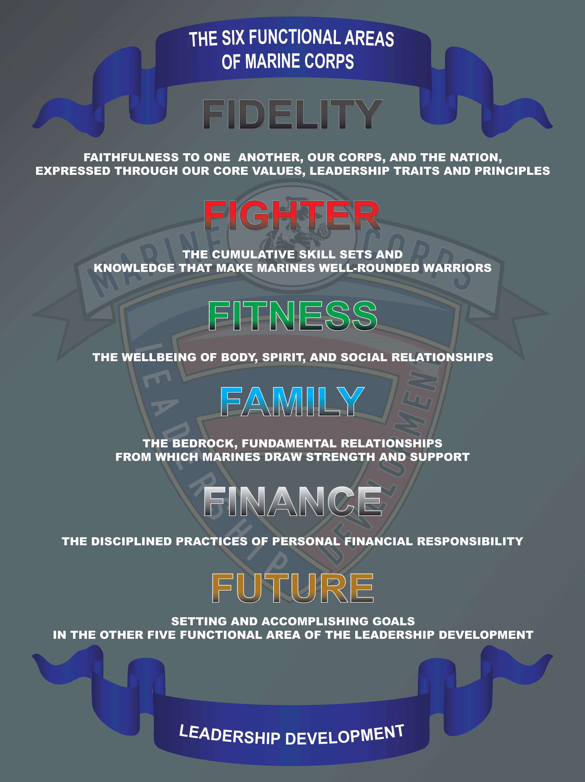
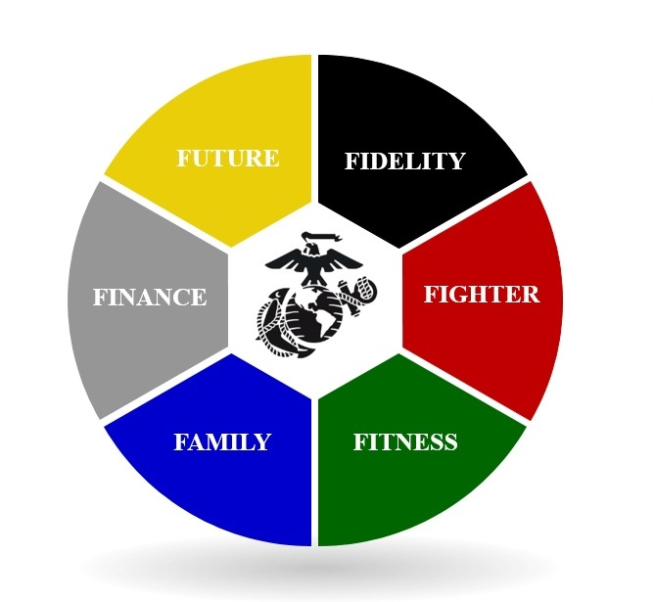
Marine Leader Development
Sep 17, 2024

Slide 3
Agenda
History
So What
How it Works
6 F’s
Initial Counseling
Subsequent Counseling
Certification Letter
Resources

Slide 4
History
The MLD initiated in 2016, Under CMC, General R. B. Neller. The MLD replaced the Marine Corps Mentoring Program (MCMP). The MLD is a comprehensive approach to leadership development that seeks to foster development of all aspects of Marines’ personal and professional lives. It is neither a philosophy nor a program; rather, it is a framework to be used by Marines at all levels for themselves and subordinates.

Slide 5
So What
As Marines, our approach to leadership means being aware of and involved in the lives
of those we lead. Effective and engaged leaders do this not to be intrusive but because
they care and because they understand there is no other way to look after the total welfare
and development of their subordinates, unless you are engaged.
Unlike any other organization,we expect our leaders to have knowledge of all aspects of the
lives of their Marines and Sailors, from the names and ages of their children to their educational
and fitness goals, and to their living conditions, both on and off base. We cannot develop
Marines to their fullest potential without truly knowing about them as individuals.
We must know their past, their present situation, and their future goals. By addressing each of
these individual areas, MLD seeks to ensure the development of Marines into cohesive,
tactically, and technically proficient, guided by moral purpose, and able to execute the toughest
challenges.

Slide 6
How it Works
In short, MLD is an engaged leadership, goal oriented, counseling session. Commanders are encouraged to establish best practices.
For example, E4 and above are counselled every 90 days while E3 and below are counselled every 30 days.
As leaders establish their relationship, they have an initial form and subsequent form used for counseling/mentoring.
These sheets are used to counsel the Marine or Sailor on their unit, section, and individual mission. They are given a billet description to establish responsibilities.
The subsequent form is used to identify the (6) functional areas, goals, action steps to achieve said goals/status, and establish a deadline. These can be maintained electronically or a counseling jacket.
There are also guided discussions that can be used in Lance Corporal Leadership and Ethics Seminar or Corporal’s Courses.

Slide 7
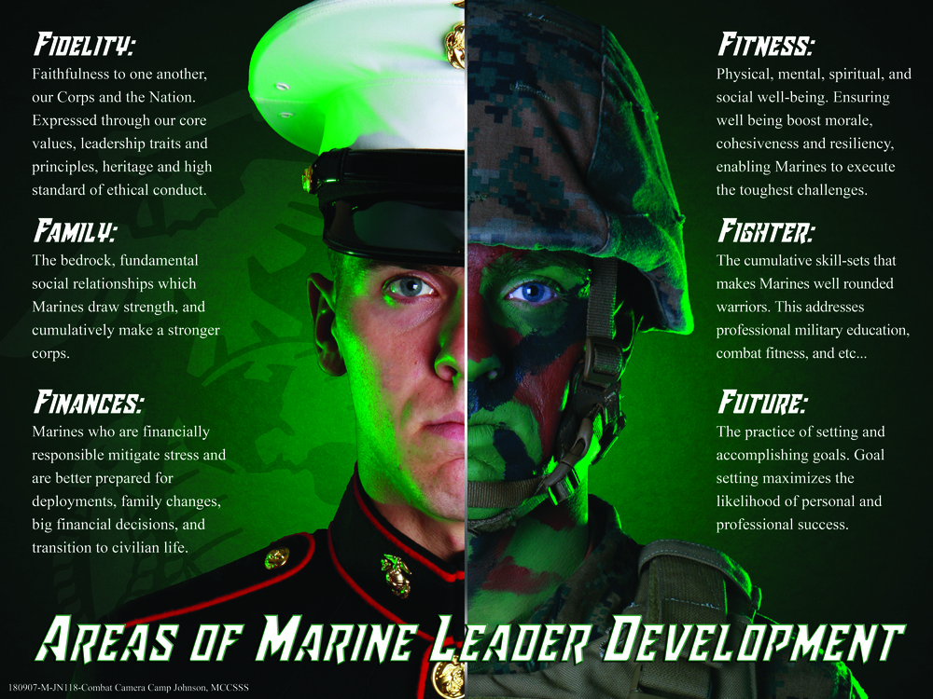
6 F’s
Sep 17, 2024

Slide 8
6 F’s
1. Fidelity. Faithfulness to one another, our Corps, and the Nation. It is expressed through our motto, “Semper Fidelis,” meaning “Always Faithful,” as well as our core values, leadership traits and principles, heritage, and high standards of ethical conduct.
2. Fighter. The cumulative skill sets and knowledge that make Marines well-rounded warriors. This addresses Professional Military Education (PME), as well as the classifications of duties, such as Military Occupational Specialty (MOS)/Navy Enlisted Code (NEC)/Navy Officer Billet Classification (NOBC), and corresponding standards of performance, interpersonal communication skills, and on and off-duty education. This area also helps focus training of both individuals and the team.
3. Fitness. Physical, mental, spiritual, and social health and well-being. Ensuring holistic well-being boosts morale, cohesiveness, and resiliency – enabling Marines to execute the toughest challenges and recuperate in shorter time.

Slide 9
6 F’s
4. Family. The bedrock, fundamental social relationships from which Marines draw strength, and cumulatively make a stronger Corps. The challenges of military life require families to be resilient like the Marines they support.
5. Finances. The disciplined practice of personal financial responsibility. Marines and Sailors who are financially responsible mitigate stress and are better prepared for deployments, family changes, big financial decisions (e.g., buying a home of vehicle), and transition to civilian life.
6. Future. The practice of setting and accomplishing goals in all the other five functional areas of leader development. Goal[1]setting maximizes the likelihood of personal and professional success, which carries through to civilian life.

Slide 10
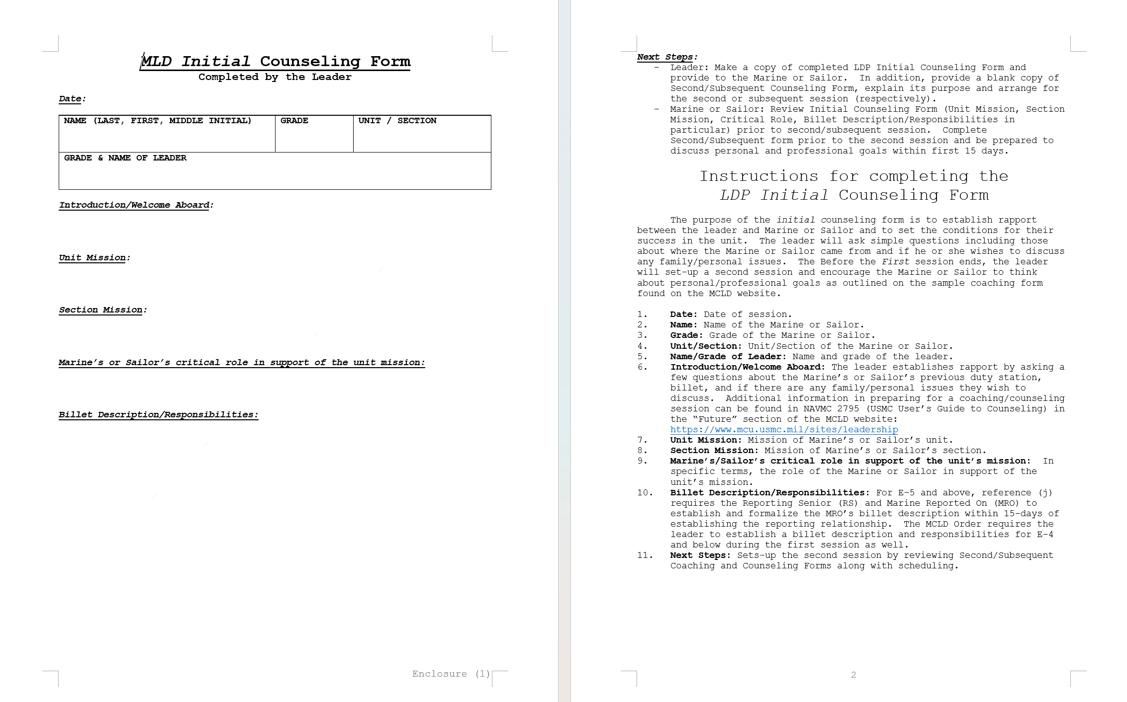
Initial Counseling
Sep 17, 2024

Slide 11
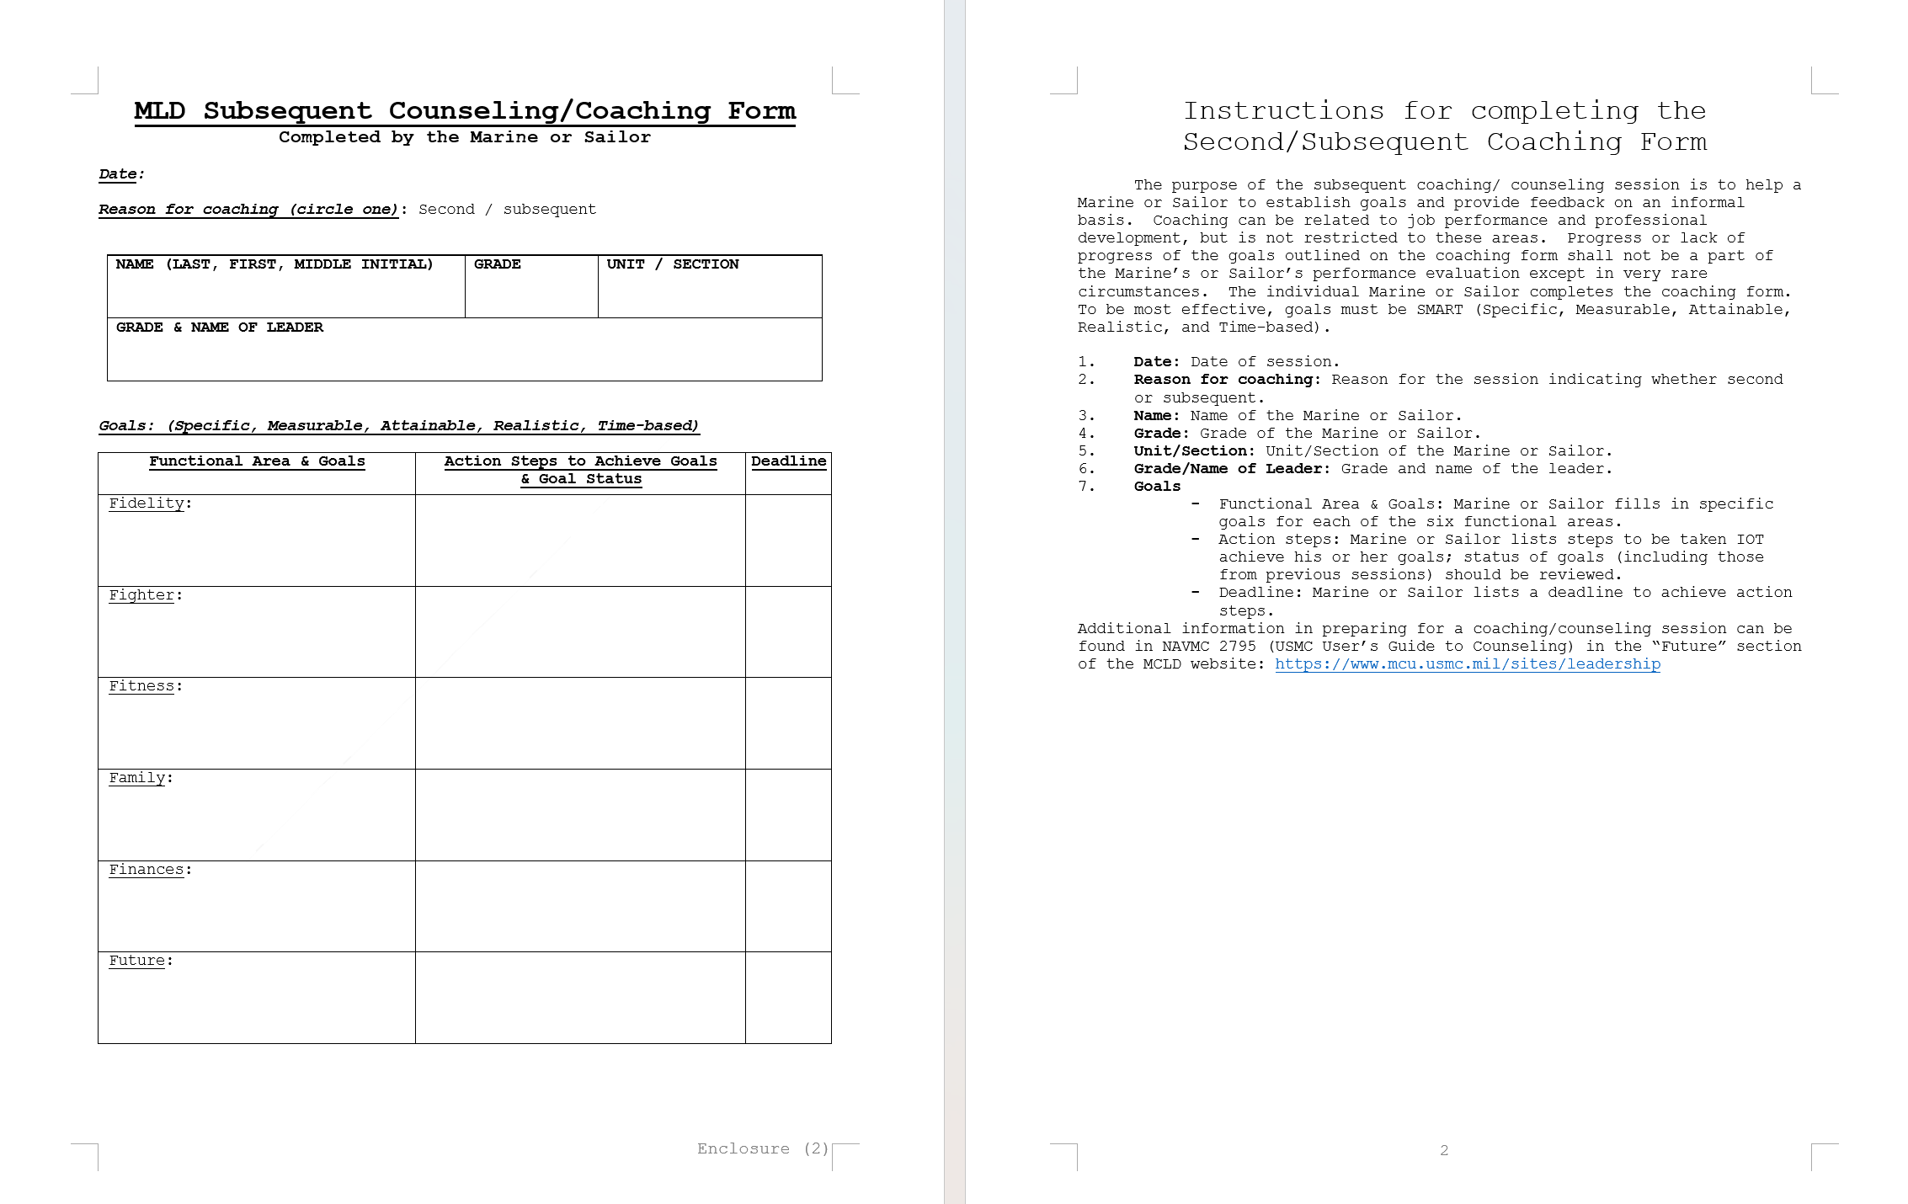
Subsequent Counseling
Sep 17, 2024

Slide 12
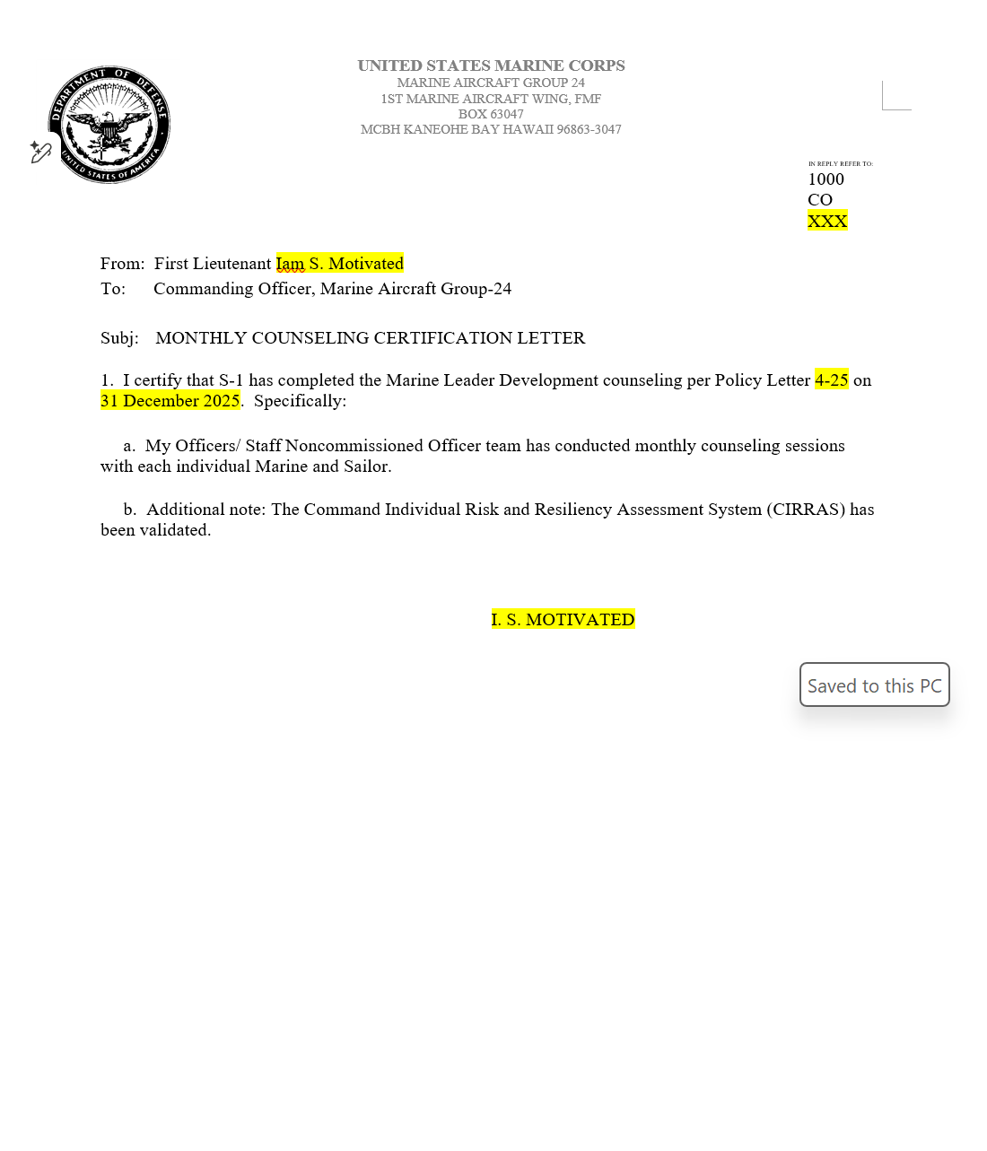
Certification Letter
Sep 17, 2024

Slide 13
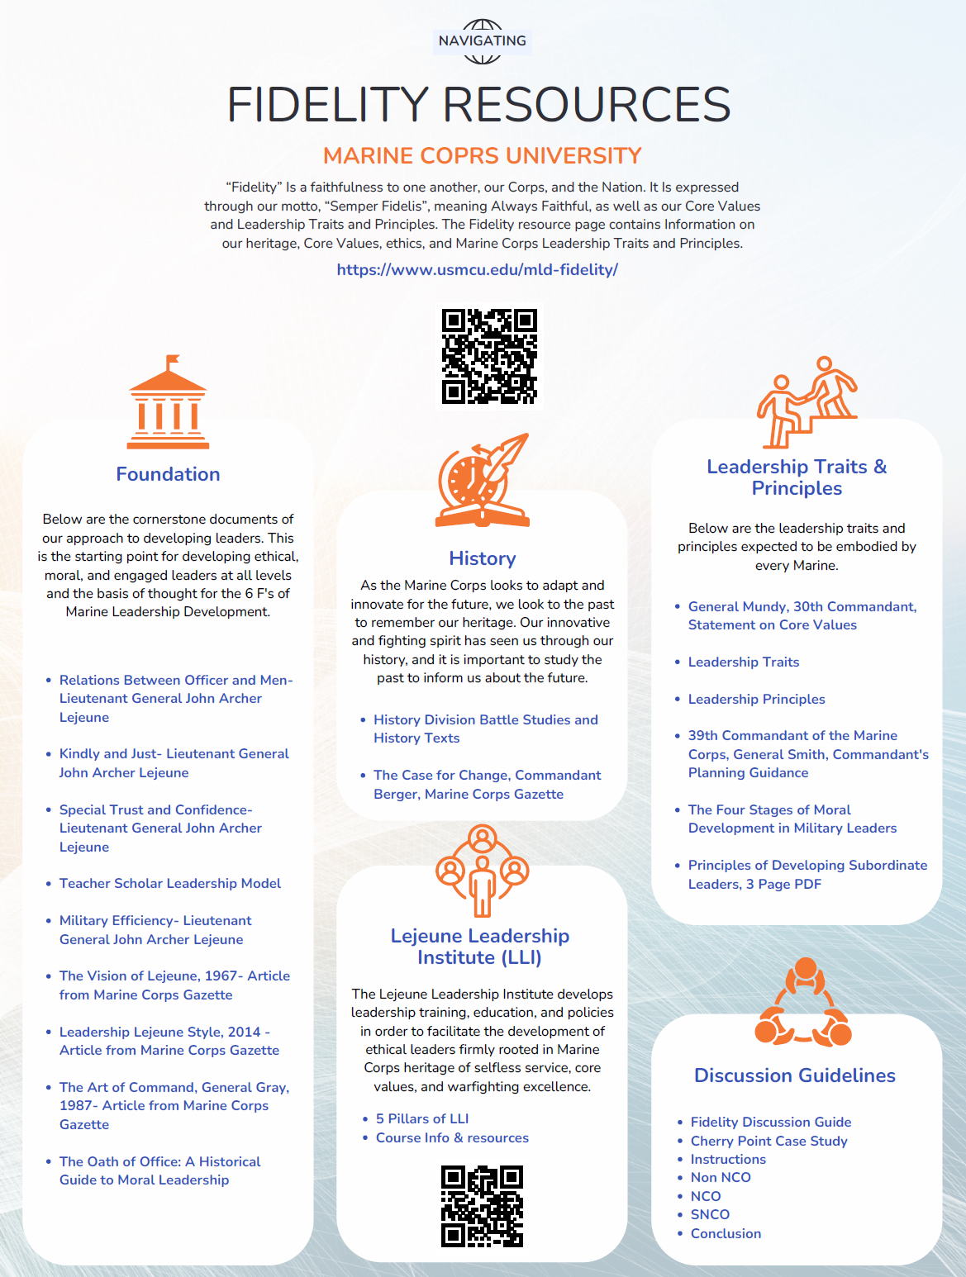
Resources
Sep 17, 2024

Slide 14
Resources
MCO 1500.61 Marine Leader Development (7 pages)
MARADMIN 394/16
Marine Leader Development (usmcu.edu)
MAG-24 Policy Letter 4-25

Slide 15
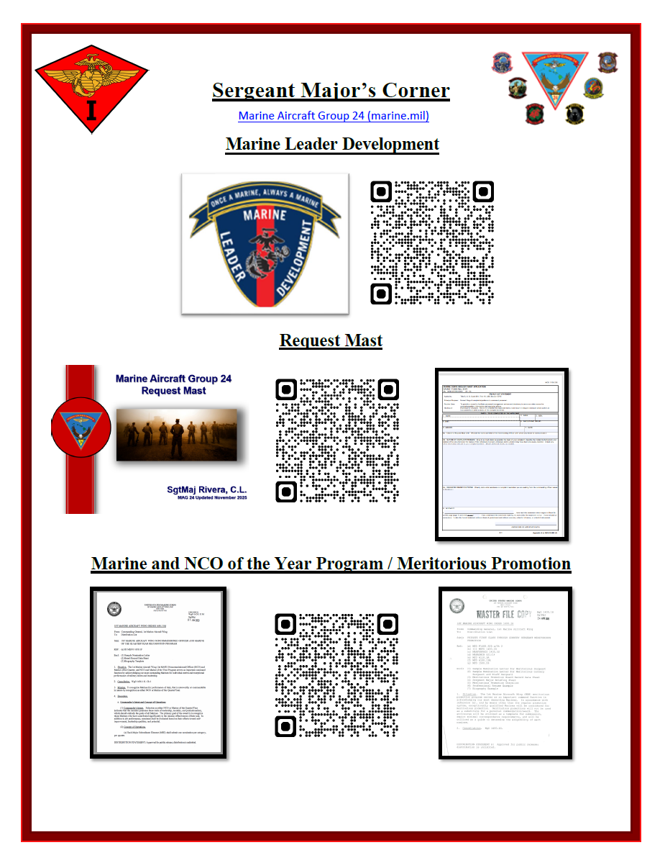
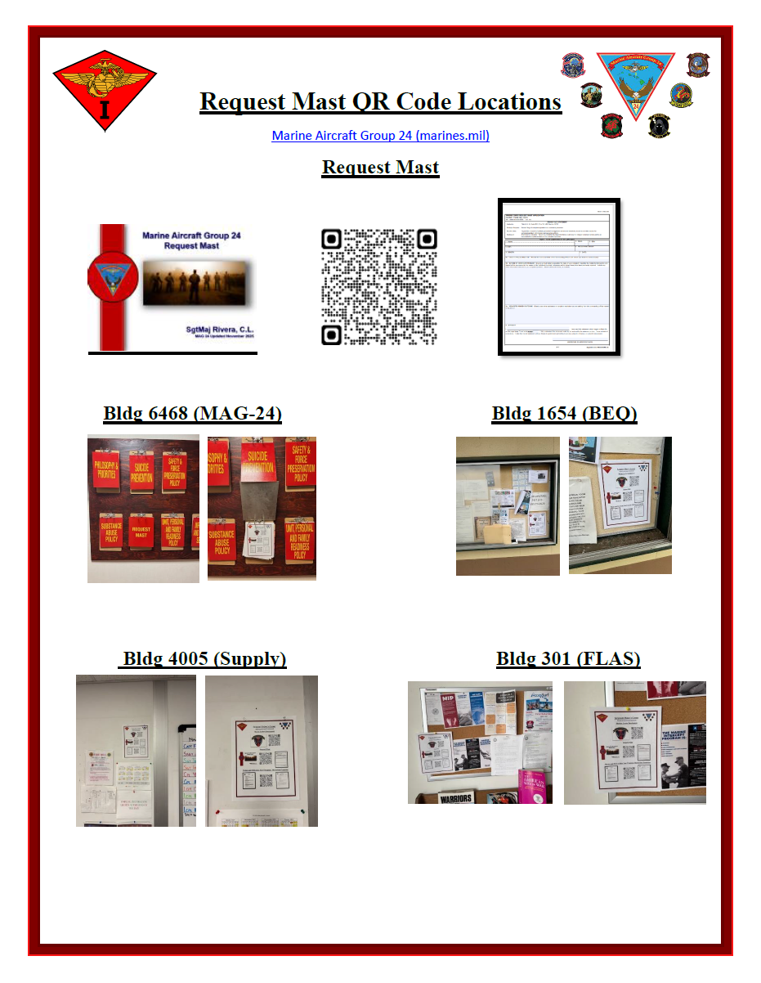
Resources
Marines, Sailors, and Officers needing assistance can utilize the QR codes posted in common areas.

Slide 16
Questions?

